Slide 1

Advanced course
Lesson 34
DIY coures（12）
Remote control handle
YahBoom Croco:Kit tutorial

Slide 2
Advanced course
Content
Part1
Part 2
Part3
Part 4
Part 5
Learning goals
Preparation
Connection
Search for blocks
Combine blocks
YahBoom Croco:Kit tutorial

Slide 3
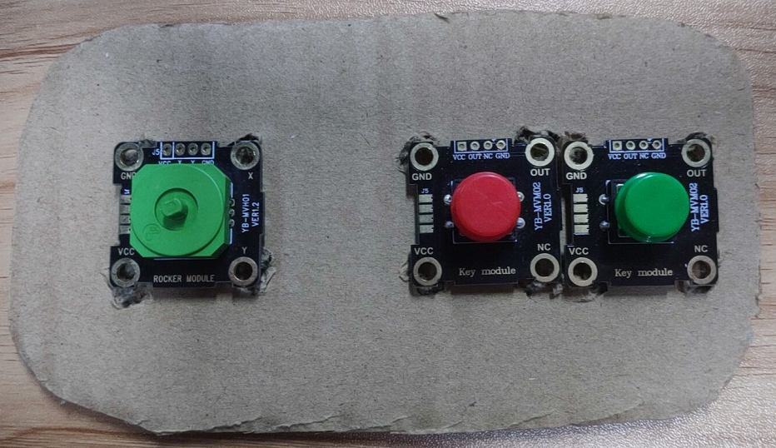
Advanced course
Part 1
Learning goals
After downloading the program, you can see that the micro:bit LED dot matrix display a “heart”.
When the handle is up, down, left and right, the corresponding direction is displayed on the micro:bit LED dot matrix. When the red button is pressed, micro:bit LED dot matrix display “R” ; When the green button is pressed, micro:bit LED dot matrix display “G” .
YahBoom Croco:Kit tutorial

Slide 4
Advanced course
Part 2
Hardware:
● 1 X Micro:bit Board
● 1 X Micro USB Cable
● 1 X Diamond breakout
● 10 X Alligator clip
● 2 X Rocker module
● 1 X Button module
● 1 X PC
Preparation
Mode 1 online programming: First, we need to connect the micro:bit to the computer by USB cable. The computer will pop up a USB flash drive and click on the URL in the USB flash drive: http://microbit.org/ to enter the programming interface. Add the Yahboom package: https://github.com/lzty634158/Croco-Kit to program.
Mode 2 offline programming: We need to open the offline programming software. After the installation is complete, enter the programming interface, click【New Project】, add Yahboom package: https://github.com/lzty634158/Croco-Kit , you can program.
YahBoom Croco:Kit tutorial

Slide 5
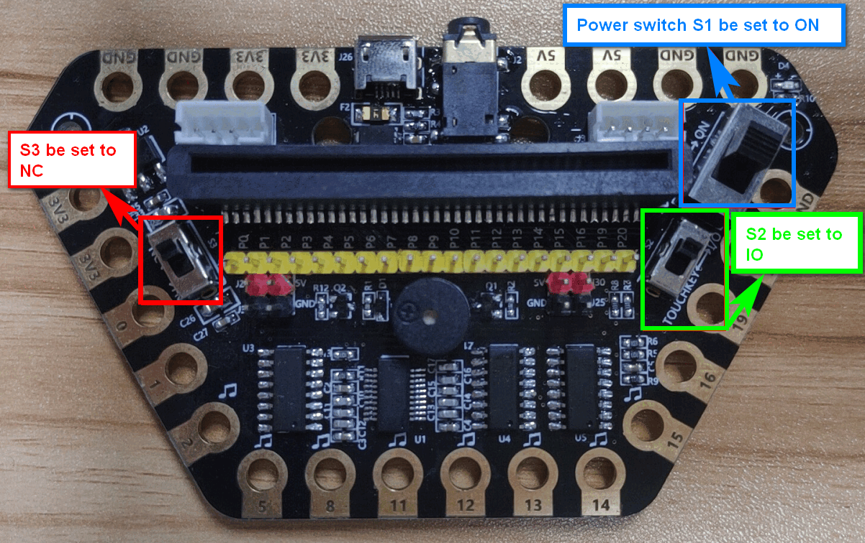
Advanced course
Part 2
Preparation
! ! !Note: S1 be set to the ON, S2 be set to the IO, and S3 to the NC.
YahBoom Croco:Kit tutorial

Slide 6
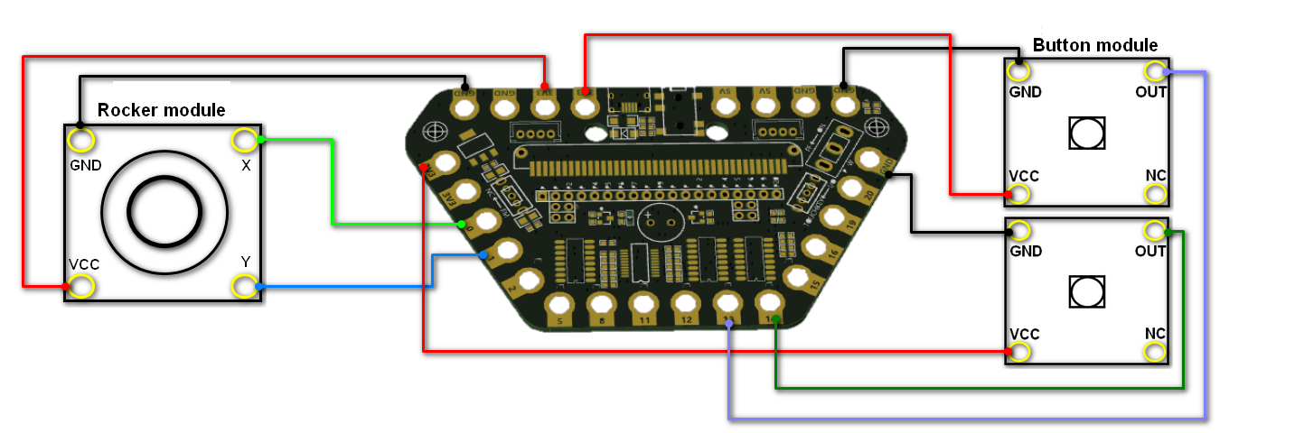
Advanced course
Part 2
Preparation
YahBoom Croco:Kit tutorial

Slide 7
Advanced course
Part 3
Expansion board | Button module (Red) | Button module (Green) | Rocker module
P0 |  |  | x
P1 |  |  | Y
P13 |  | OUT
P14 | OUT
3.3V | VCC | VCC | VCC
GND | GND | GND | GND
Connection
YahBoom Croco:Kit tutorial

Slide 8
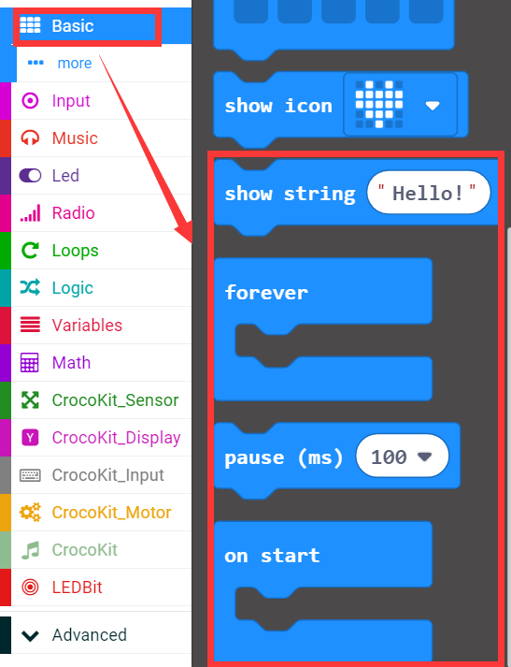
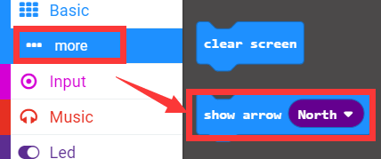
Advanced course
Part 4
Search for blocks
YahBoom Croco:Kit tutorial

Slide 9
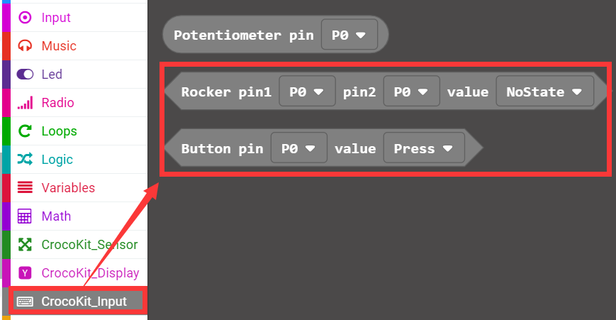
Advanced course
Part 4
Search for blocks
亚博智能 Croco:Kit视频教程

Slide 10
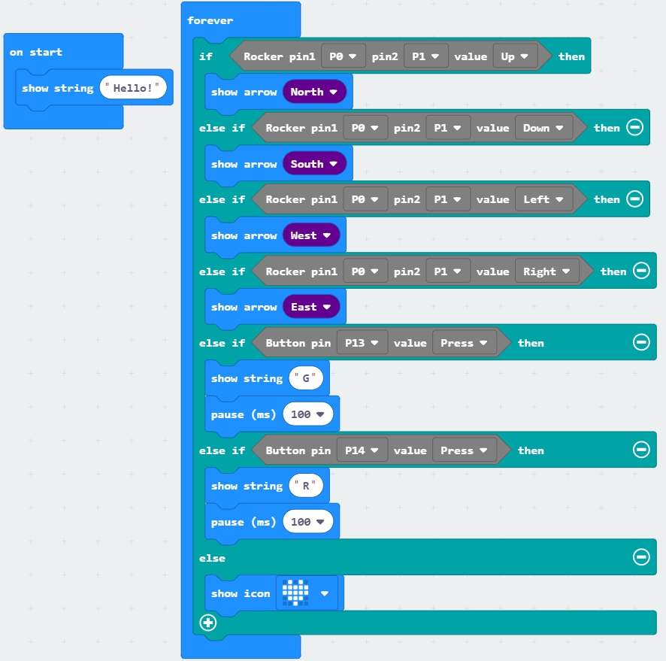
Advanced course
Part 5
Combine blocks
YahBoom Croco:Kit tutorial

Slide 11
Advanced course
Thank you ！
Powered by YahBoom
YahBoom Croco:Kit tutorial

